Slide 1
Adopting a DevSecOps mindset union of people, process, technology
Digvijay Patil (DevOps Engineer)
26.07.2022

Slide 2
Agenda
Industry trend
Driving the initiative
Challenges
Shift left- Continuous Testing
Continuous Security
Shift left- Continuous Automation
Security Automation
Secure Product Lifecycle
Hands-on Experience
Demo
Maturity Journey

Slide 3
Industry Trends
Digital Transformation
Cyber space
In-house software development to speed up development cycle
>> Leads to adopt right practices

Slide 4
Driving the Initiative..
Define Processes
Bridge a gap between teams (DevOps, Security, Product team)
Evaluate Tools (modern s/w architecture, APIs, shallow learning curve, seamless integration)
Start Automation
Modify existing SDLC to Secure SDLC
Start with small step and shift-left gradually
Improve the security posture of organization
Maintain Comprehensive Documentation
Notes:
Onboard people : Team topology Product & operation team should feel comfortable & confident for security practises , feel connected , tools can be anyway learned. , As both sides can have different priorities and agendas, having good communication skills and being a people person may help a lot while trying to play ball with both teams.

Slide 5
Challenges
DevOps Engineer
Right choice of tools for integration
Frictionless integration
Define Process
Security Personnel
Right choice of tools for security
Up-to-date with security knowledge
Make product team comfortable for security practices
Define Process

Slide 6
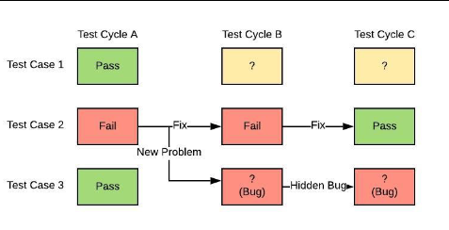
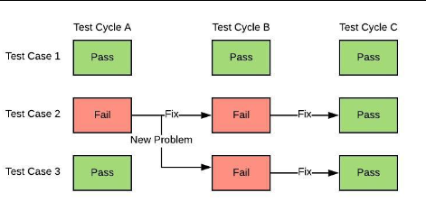
Shift Left - Continuous Testing
Source: Randy Rice. Software Testing Training - Regression Testing. Youtube. 2013. Url: https://www.youtube.com/watch?v=5A7J5cM2e7c.

Slide 7
Continuous Security
Security testing/Security audit on final source code takes 4-5 days.
We can take small chunk of source code and do the testing on top of it.
Integrating security in DevOps will help to accommodate this testing.
Continuous Security i.e. CI/CS/CD

Slide 8
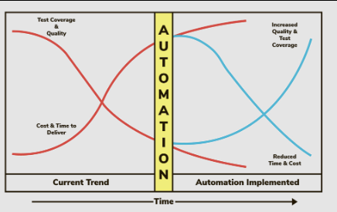
Shift Left - Continuous Automation
Aim : Discover defects in a short time
Source: https://www.sealights.io
The right choice of a tool plays an important role in adopting automation

Slide 9
Security Automation
Why ?
Overloaded with abundant security alerts
Various tools for detection, investigation, remediation >> Lots of consoles
Poor documentation of security processes
Shortage of talent
Solution
Plug your security tools into CI/CD practises using Vendor provided APIs/CLI
Run automated scripts to fetch consolidated data from security tools
Source: Libby Reichenberg. What is Security Orchestration and Automation. Youtube. 2018. Url: https://www.youtube.com/watch?v=RJafMxfQ_IY&t=361s
Notes:
Why? It is important from the security person point of view

Slide 10
Tool Evaluation
From Integration perspective
Enable applications’ data and functionality to third party developers using API (RESTful) service of a application
Include authorization credentials, unique tokens, signatures, TLS encryption for API calls
Enable built-in command-line interface (CLI) or scripting/console interface support (command prompt, PowerShell, bash, remote terminal programs (PuTTY, SSH))
From performance perspective
Provide right scan policy, risk assessment, less false positives
Provide good API documentation
Notes:
Any tool can decrypt the credentials then what is purpose of encryption
Solution is to separate the credentials from the script/code into a configuration file. While the script/code without explicit credentials can be safely stored into a revision system and be otherwise accessible, the configuration file should be protected as much as possible. Particularly its file permissions should be restricted only to administrators (for writing) and user under which the script/code runs (for reading). The configuration file can also be encrypted

Slide 11
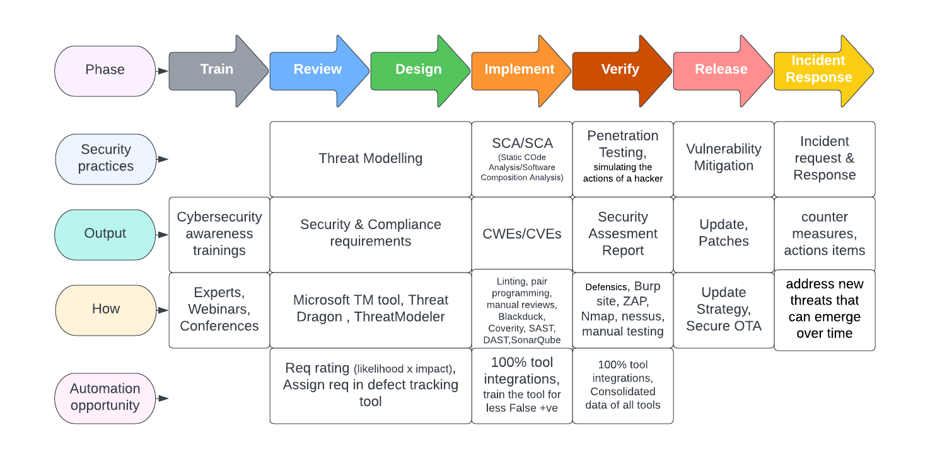
Secure Product Development Lifecycle
Source: Eaton. Secure development lifecycle. 2018. Url: shorturl.at/rvxZ0.
Notes:
CWE Common Weakness ENumeration, database maintained by Mitre
CVE Common Vulnerabilities and Exposures, database maintained by National Vulnerability Database
Software Composition Analysis : third-party components (commercial & open-source)

Slide 12
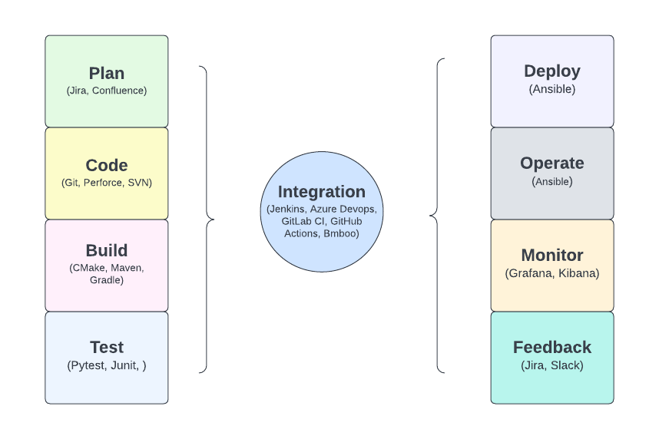
DevOps

Slide 13
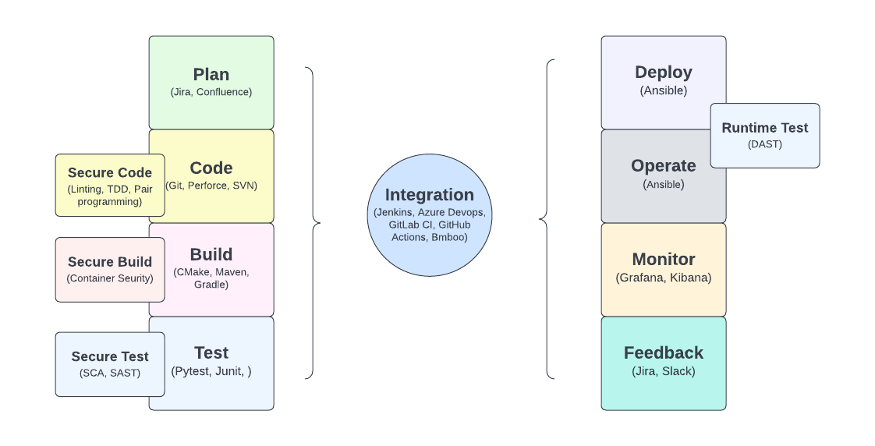
DevSecOps
Plug-in Security Testing methods into Devops
Notes:
Application Security Testing methods
SAST Sonarqube, Snyk code, LGTM
DAST (OWASP ZAP)
SCA Fortify, snyk, checkmarx, synopsys

Slide 14
Hands-on Experience
Configured Authorization flows (Jenkins, GitHub, Slack, Redmine)
OAuth 2.0 Protocol Integration
Coordinated with ITOps & NetOps Team for CI infrastructure maintenance
Asset Management tool (Lansweeper)
security management tool (Falcon Sensor)
DAST tool integration

Slide 15
Demo
Perform DAST scan on demo website http://demo.testfire.net
Tools
Jenkins v.2.346.2
PowerShell v1.7
Git v2.37.1
ZAP v2.11.1
Using OWASP ZAP Standalone application
Using OWASP ZAP CLI
java -jar zap-2.11.1.jar -cmd -quickurl http://demo.testfire.net -quickprogress -quickout report.xml
Report back handful vulnerabilities

Slide 16
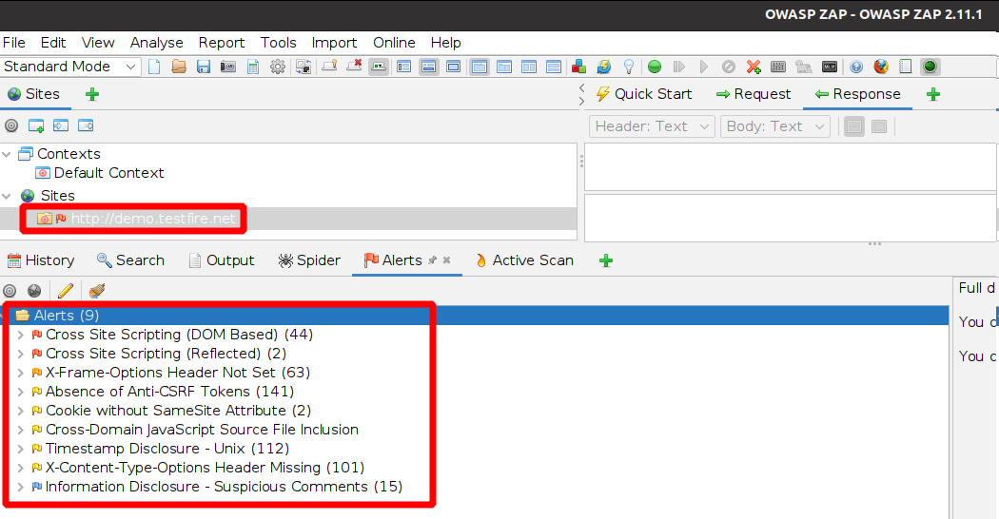
Standalone DAST

Slide 17
Automated DAST
Install CI Server (Jenkins) on your machine
Install Powershell plugin on CI Server
Install Git, Java, Powershell on your machine
Choose demo website for DAST scan
Copy ZAP jar file from GitHub in Jenkins Workspace
Run java command against demo website
Export scan result into XML file
Powershell script to fail/pass the build
Archive Artifacts

Slide 18
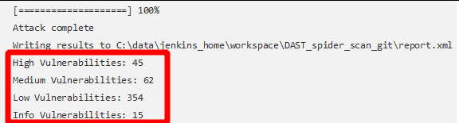

Automated DAST

Slide 19
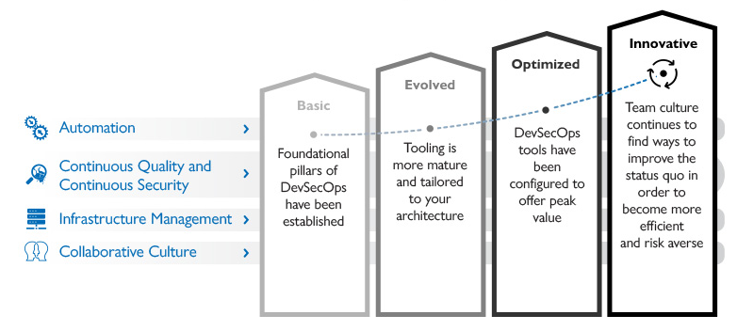
DevSecOps Maturity Journey
Source: SAIC. DevSecOps Journey. 2021. Url: https://www.saic.com/features/devsecops-journey-how-to-go-from-a-strong-foundation-to-maturity-and-maximized-results

Slide 20
DevSecOps is not a destination.
It is long-term Journey……………….
……………………………………………….……………….
……………………………………………….………………
……………………………………………….…Thank you!

